Slide 1
Transmission Control Protocol
Introduction to Computer Networks
CSC358
Reliable Transport &
Congestion Control
Dr. Michael A. Galle
January 24, 2025
Inspired by the lectures of Prof. Peter Marbach

Slide 2
Objective
By the end of this class, you will understand:
Reliable Transport and how it is implemented in TCP
The need for Congestion Control and its implementation in TCP
Enhancements and special overhead reduction algorithms in TCP
All materials for this lecture are available in the course repo
git clone https://github.com/michaelgalle/ComputerNetworks.git

Slide 3
Overview
Bridge-in
Reliable Transport
Congestion Control
Flipped-classroom Exercise
TCP congestion control enhancements / algorithms

Slide 4
1. Bridge-in
Layered communication
Routing
Addressing
Transport layer protocols
Reliable transport
Congestion control

Slide 5
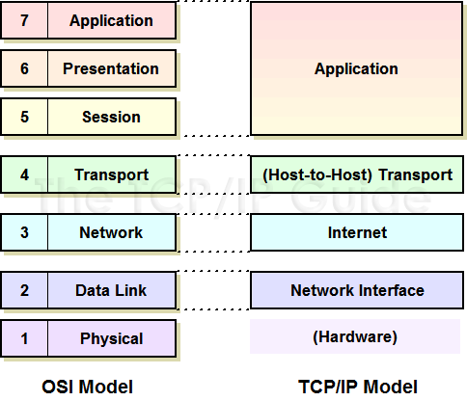
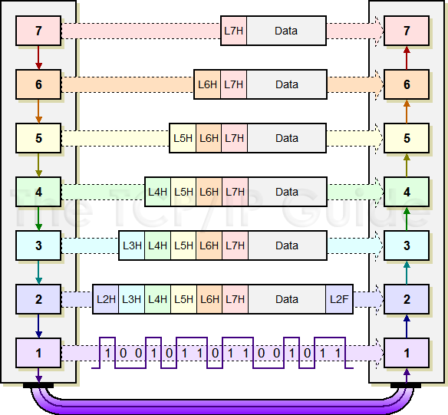
1. Bridge-in
Data
Data
Encapsulate
Data
Decapsulate
Data
Data
tcpipguide.com
Notes:
http://www.tcpipguide.com/free/t_TCPIPArchitectureandtheTCPIPModel-2.htm
http://www.tcpipguide.com/free/t_DataEncapsulationProtocolDataUnitsPDUsandServiceDa.htm

Slide 6

1. Bridge-in
Computer Networking: A Top-Down Approach 6th edition, Jim Kurose, Keith Ross Addison-Wesley
message
M
application
transport
network
link
physical
segment
H_{t}
M
H_{t}
datagram
H_{n}
H_{n}
H_{t}
M
frame
H_{l}
H_{n}
H_{t}
M
Source
link
physical
switch
M
application
transport
network
link
physical
H_{t}
H_{n}
H_{t}
M
network
link
physical
M
H_{n}
H_{t}
M
H_{l}
H_{n}
H_{t}
M
H_{n}
H_{t}
M
H_{l}
H_{n}
H_{t}
M
Destination
router

Slide 7
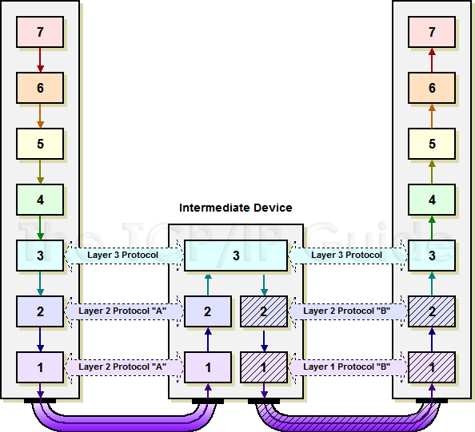
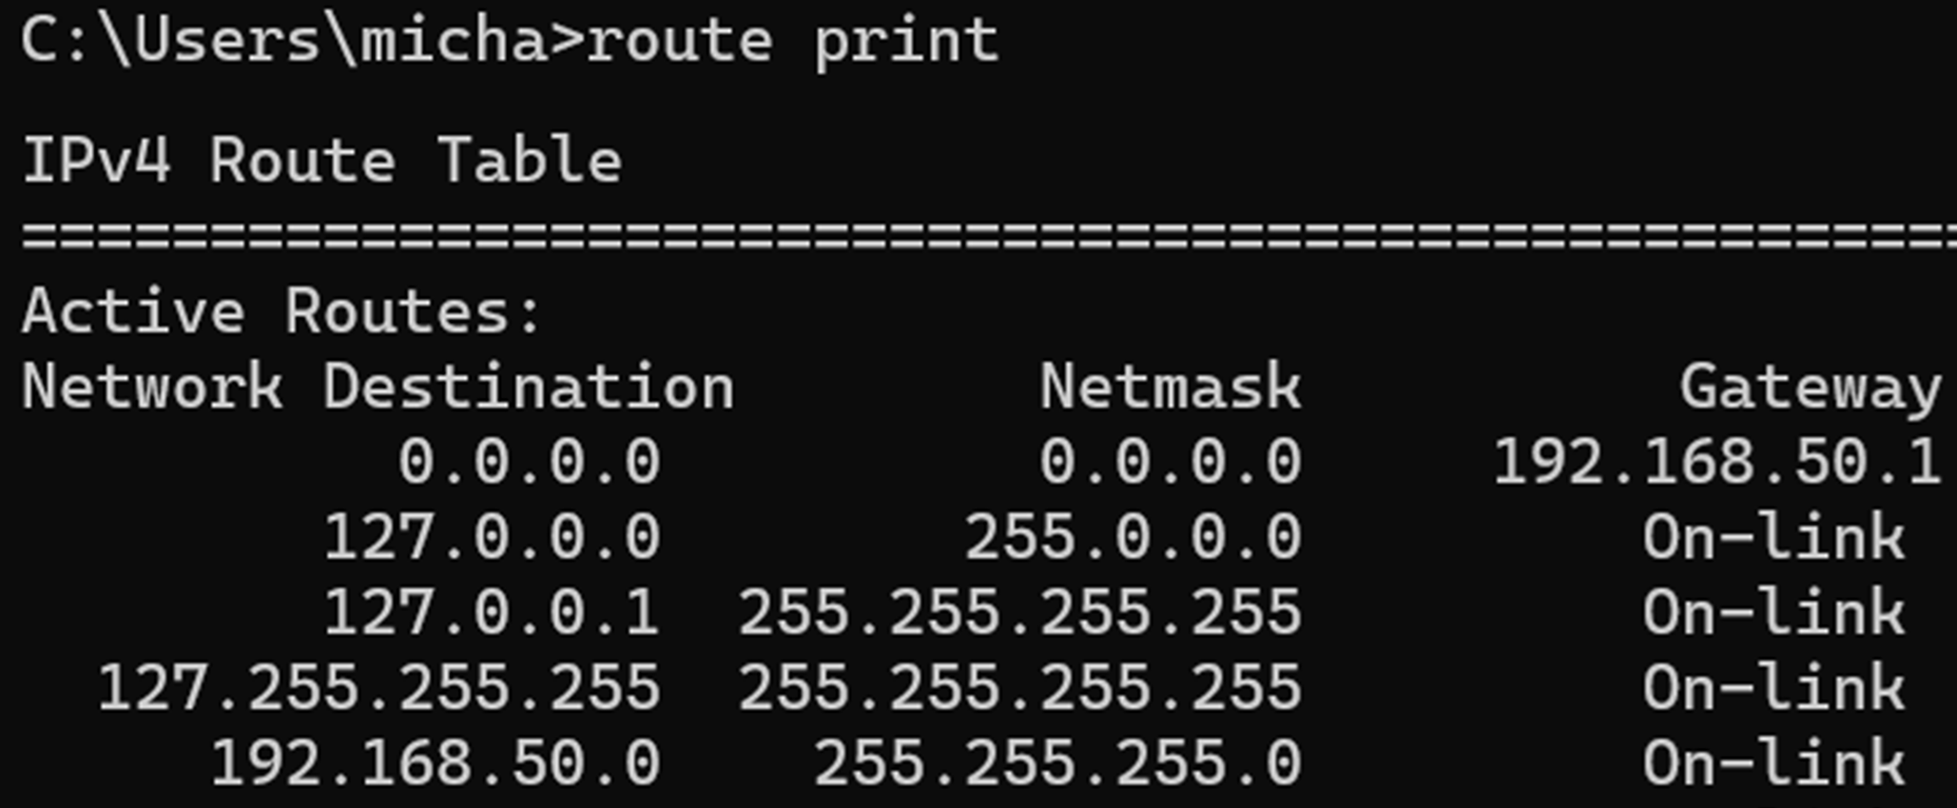
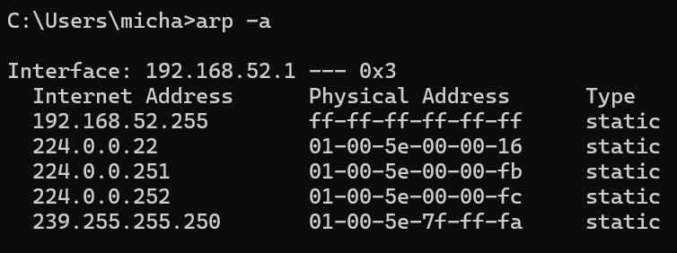
1. Bridge-in
Routing table:
IP-to-next-hop IP
Router(s)
ARP Table:
IP to MAC
tcpipguide.com
Notes:
http://www.tcpipguide.com/free/t_IndirectDeviceConnectionandMessageRouting.htm

Slide 8
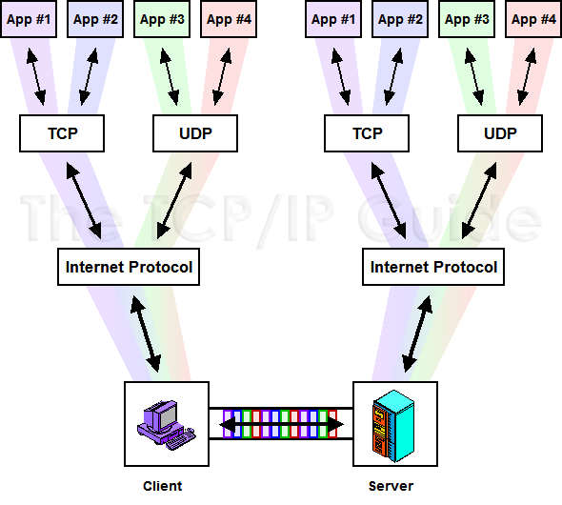
1. Bridge-in
192.168.1.2 at port 53 using TCP
IP address
Port #
Protocol
Socket
tcpipguide.com
Notes:
http://www.tcpipguide.com/free/t_IndirectDeviceConnectionandMessageRouting.htm

Slide 9
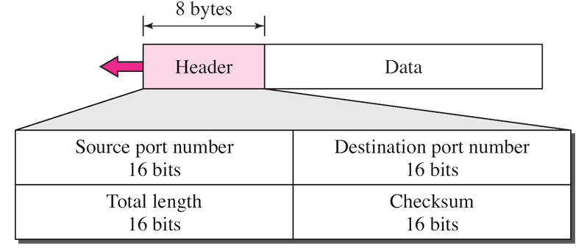
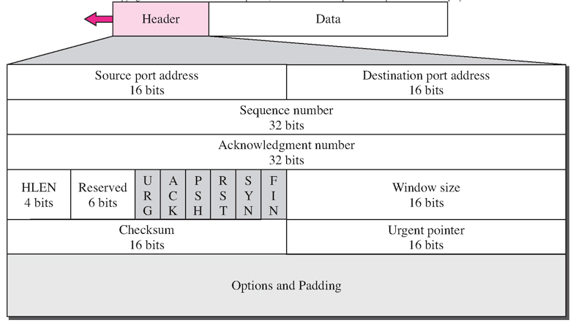
1. Bridge-in
UDP packet structure
TCP packet structure
Data Communications and Networking, By Forouzan, McGraw-Hill
Notes:
Data Communications and Networking, By Forouzan, McGraw-Hill

Slide 10
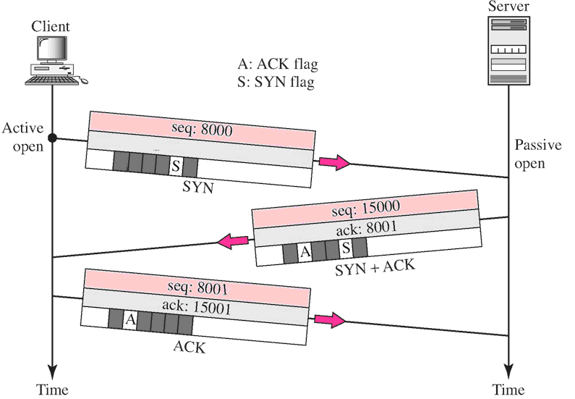
1. Bridge-in
Connection-oriented transport
Data Communications and Networking, By Forouzan, McGraw-Hill
Notes:
Data Communications and Networking, By Forouzan, McGraw-Hill

Slide 11
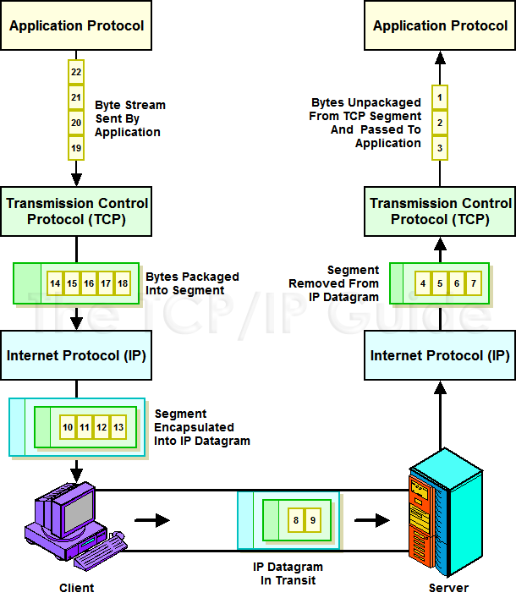
1. Bridge-in
Reordered Based on Sequence number in TCP header
tcpipguide.com
In-sequence delivery
Notes:
http://www.tcpipguide.com/free/t_TCPDataHandlingandProcessingStreamsSegmentsandSequ-2.htm

Slide 12
1. Bridge-in
If your network is not reliable, what can happen to your packets?
What can you do when this happens?
Loss
Corruption (bit error)
Retransmit them

Slide 13
1. Reliable Transport
Reliable transport is the ability to recover from packet loss and corruption
TCP achieves this by retransmitting these packets
This is a type of Automatic Repeat Request (ARQ) scheme

Slide 14
1. Reliable Transport
How can we keep track of the packets that may get lost?
How will we know if they got lost?
Number them
Ask the receiver

Slide 15
1. Reliable Transport
What numbers can we use?
Transmitters sent packet
Receiver’s response (to transmitter)
I got everything up to 10, expecting 11 next …
Sent # →
Packet # 10
Received # →
Packet # 11
Data Communications and Networking, By Forouzan, McGraw-Hill

Slide 16
1. Reliable Transport
Let’s see one way this could work …
Send message to recipient
Stop-and-wait for acknowledgement (ACK) from receiver
Send next packet on successful ACK
What is wrong with this?
Waiting period slows throughput

Slide 17
1. Reliable Transport
How could we improve throughput?
Send a group of packets at a time
Let’s allow up to N packets to be sent before requiring an ACK

Slide 18
1. Reliable Transport
What do we have to do when some of the N packets are lost?
Resend all of them
(Go-back-to-N retransmission scheme)
What’s wrong with this?
Resends even the successful packets → wastes bandwidth

Slide 19
1. Reliable Transport
Can we do better?
Resend only the lost packets
Can we actually do this?
Yes, but this is a TCP enhancement
Selective Acknowledgement (SACK), will be discussed later in the lecture

Slide 20
1. Reliable Transport
Since the transmitter only gets an ACK for successful packets, how does it know that a packet was not successful (lost or corrupted)?

Slide 21
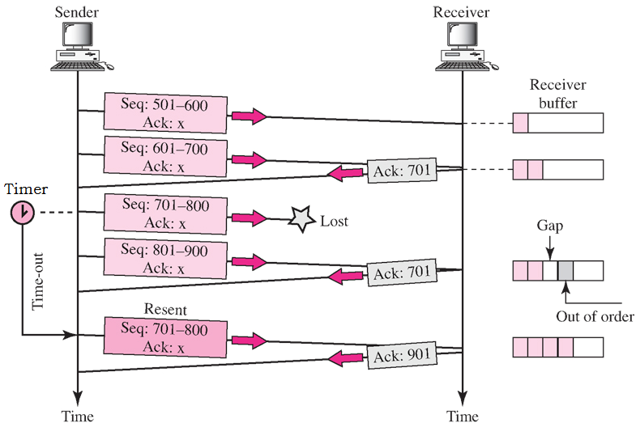
1. Reliable Transport
Retransmission Type 1:
Time-out
Counter reaches 0 with no ACK
Retransmission type 2:
Fast Retransmission
after duplicate ACK number
On transmission the sender starts count-down timer, if it reaches zero it assumes the packet was lost and retransmits
If transmitter receives the same ACK number more than once it assumes the most recent segment was lost and retransmits
Data Communications and Networking, By Forouzan, McGraw-Hill

Slide 22
1. Reliable Transport
So TCP is reliable because it tracks packets (by numbering them) and retransmits when they are lost or corrupted
Next up …. Flow & Congestion Control

Slide 23
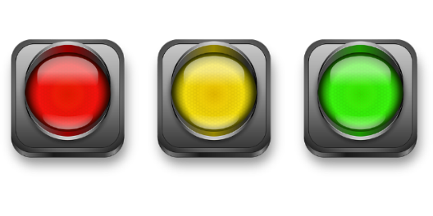
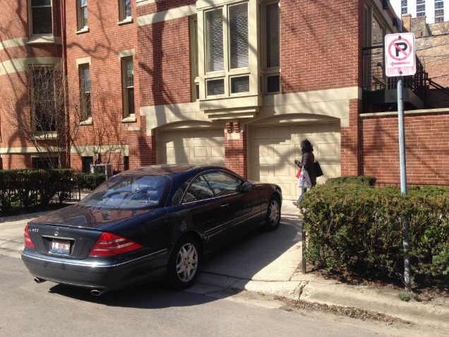
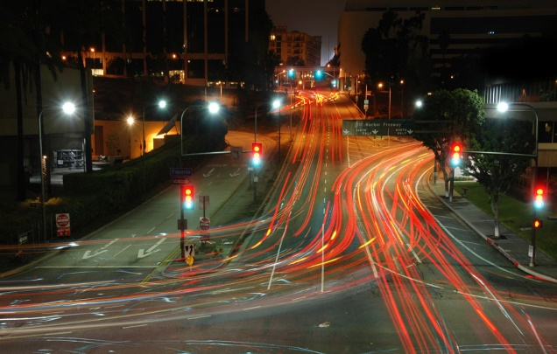
2. Congestion Control
Flow control
Receiver alerts sender about the capacity in its buffer
Sender adjusts Tx rate accordingly
Congestion control
Intermediate routers to drop packets on congestion
Sender monitors for lost packets and adjusts Tx rate
No parking at destination, don’t leave
Traffic on the route, don’t leave
This Photo by Unknown Author is licensed under CC BY-ND
This Photo by Unknown Author is licensed under CC BY-NC-ND

Slide 24
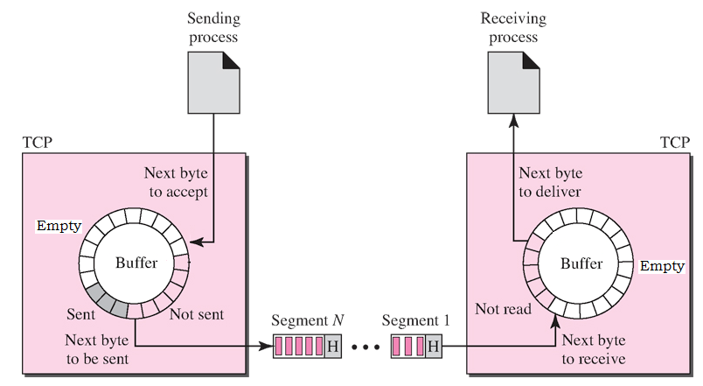
2. Congestion Control
Why do we need flow control?
If the inflow rate is higher than the outflow rate the Rx buffer will overflow.
Sender and receiver TCP ring buffers
Data Communications and Networking, By Forouzan, McGraw-Hill

Slide 25
2. Congestion Control
How does the receiver tell the sender how big its buffer is?
TCP ACK packet to sender
Data Communications and Networking, By Forouzan, McGraw-Hill

Slide 26
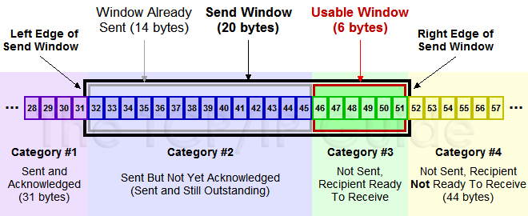

2. Congestion Control
How does the Tx know how much room is left at any given time?
It must keep track of sent (but not yet ACK’d) packets
$$\left[\begin{aligned}Usable \\ Window\end{aligned}\right]=\left[\begin{aligned}Send \\ Window\end{aligned}\right]−\left[\begin{aligned}Window Already \\ Sent, no ACK\end{aligned}\right]$$

Slide 27

2. Congestion Control
Flow control
Receiver alerts sender about the capacity in its buffer
Sender adjusts Tx rate accordingly
Congestion control (up next)
Intermediate routers to drop packets on congestion
Sender monitors for lost packets and adjusts Tx rate
No parking at destination, don’t leave
Traffic on the route, don’t leave
This Photo by Unknown Author is licensed under CC BY-ND
This Photo by Unknown Author is licensed under CC BY-NC-ND

Slide 28

2. Congestion Control
Why do we need congestion control?
Congestion Collapse
On congestion routers drop packets
Transmitters timeout expires or duplicate ACK
Transmitter retransmits dropped packet → More congestion
Prevent me
Traffic gridlock
Congestion → Drop → Retrans. → Collapse
Not good, positive feedback loop

Slide 29

2. Congestion Control
How can we avoid congestion collapse?
Negative feedback
How?
On packet drop, restrict the Send Window to slow (re)transmission
Currently the Send Window is only determined by the receiver’s window
$$Send Window=RcvWin$$

Slide 30



2. Congestion Control – TCP Tahoe
How can we restrict the Send Window?
Define a Congestion Window ( ) so that:
$$CongWin$$
$$Send Window=\min{ \left(RcvWin, CongWin\right)}$$
If we assume that most of the time then:
$$RcvWin≫CongWin$$
$$Send Window=CongWin$$
Send Window is mainly determined by the congestion window

Slide 31


2. Congestion Control
$CongWin$is an integer multiple (w) of the max segment size (MSS)
The main variable we will change is w
This congestion control method is known as TCP Tahoe (Slow Start) Algorithm
536 bytes by default
$$CongWin=w×MSS$$

Slide 32
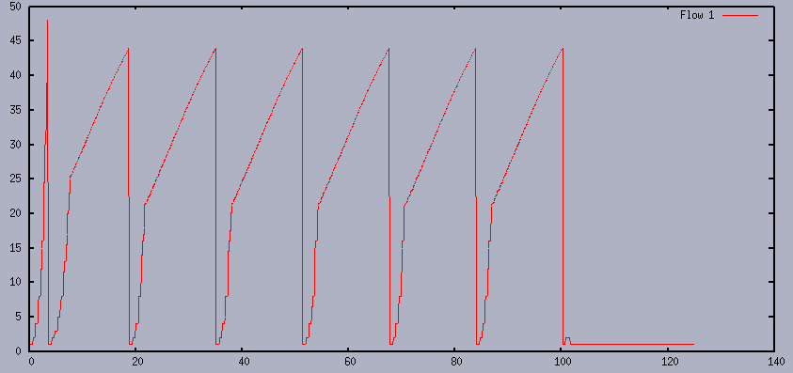
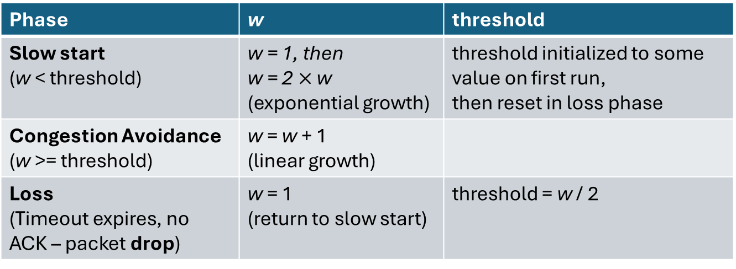


2. Congestion Control
$$CongWin=w×MSS$$
Drop
Drop
$$w$$
Phase | w | threshold
Slow start (w < threshold) | w = 1, then w = 2$×$w (exponential growth) | threshold initialized to some value on first run, then reset in loss phase
Congestion Avoidance (w >= threshold) | w = w + 1 (linear growth)
Loss (Timeout expires, no ACK – packet drop) | w = 1 (return to slow start) | threshold = w / 2
w
Cong. Avoidance
(Linear growth)
w/2
threshold
Slow Start
(Exponential growth)
Sent packets
w increments with every sent packet
http://www.cs.emory.edu/~cheung/Courses/455/Syllabus/A1-congestion/tcp2.html

Slide 33
2. Congestion Control
Great, so we can prevent congestion collapse, but how does this algorithm affect our transmission rate?
$Send Window=CongWin=w×MSS$ [bytes]
Unit analysis: Transmission rate has units of [bytes / s], so we need something for the denominator in seconds

Slide 34
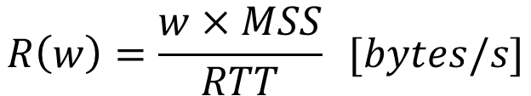
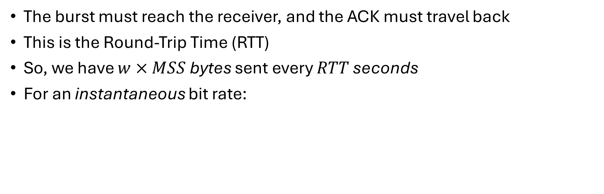
2. Congestion Control
If the transmitter sends all w segments in one burst, how long must it wait before it can send another one?
The burst must reach the receiver, and the ACK must travel back
This is the Round-Trip Time (RTT)
So, we have $w×MSS$ bytes sent every $RTT$ seconds
For an instantaneous bit rate:
$$R\left(w\right)=\frac{w×MSS}{RTT} [bytes/s]$$
But what we really care about is the average bit rate
Need to find the average value of w (w_{avg})

Slide 35





2. Congestion Control
We can approximate by ignoring the slow start phase and considering only the linear phase where w grows from M/2 to M and then returns to 1 in M/2 + 1 steps
$$w_{avg}$$
$$w$$
$$w$$
M
M
$$w_{avg}$$
$$w_{avg}$$
Cong. Avoid. Phase (use w values here)
M/2
M/2
Area
Slow Start Phase (Ignore w values here)
width
Sent packets
Sent packets
0
M/2 + 1
http://www.cs.emory.edu/~cheung/Courses/455/Syllabus/A1-congestion/tcp2.html

Slide 36





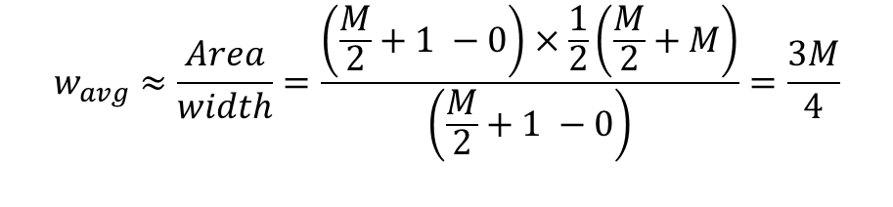
2. Congestion Control
Approximate in terms of M via the trapezoid rule
And the Average Transmission Rate is:
$$w_{avg}$$
$$w$$
$$Area≈(last −first)×\frac{1}{2}(f\left(first\right)+f\left(last\right))$$
M
$$w_{avg}$$
$$w_{avg}≈\frac{Area}{width}=\frac{\left(\frac{M}{2}+1 −0\right)×\frac{1}{2}\left(\frac{M}{2}+M\right)}{\left(\frac{M}{2}+1 −0\right)}=\frac{3M}{4}$$
M/2
Area
width
Sent packets
0
M/2 + 1
$$R\left(w_{avg}\right)≈\frac{w_{avg}×MSS}{RTT}=\frac{3M}{4}×\frac{MSS}{RTT}$$

Slide 37


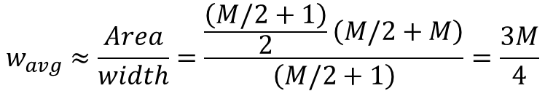
2. Congestion Control
Alt.: Approximate using Gauss’s formula for the sum of n consecutive integers
And the Average Transmission Rate is:
$$w$$
$Area≈\frac{n}{2}\left(first+last\right), n is \# of integers (i.e.,M/2+1)$
M
$$w_{avg}$$
M/2
$$w_{avg}≈\frac{Area}{width}=\frac{\frac{\left(M/2+1\right)}{2}\left(M/2+M\right)}{\left(M/2+1\right)}=\frac{3M}{4}$$
Area
width
Sent packets
0
M/2 + 1
$$R\left(w_{avg}\right)≈\frac{w_{avg}×MSS}{RTT}=\frac{3M}{4}×\frac{MSS}{RTT}$$

Slide 38
Summary
Reliable transport is the ability to recover from packet loss & corruption.
TCP achieves this by numbering and retransmitting lost packets
TCP implements flow and congestion control techniques to prevent overflow of the receiver’s buffer and congestion collapse on the network.
Flow and congestion control techniques regulate the transmission rate

Slide 39
3. Flipped Classroom
In this active learning exercise, the class is divided into 4 groups to present one of the TCP topics (below):
Explicit Congestion Notification (ECN)
Selective Acknowledgement (SACK)
Small Packet Problem (solution – Nagle’s Algorithm)
Silly Window Syndrome (solution – Clark’s Algorithm)
Resources include
Editable flipped classroom slides (originals follow)
Section 3 of the notes that accompany this lecture

Slide 40
3. Explicit Congestion Notification (ECN)
A TCP protocol enhancement that enables congestion reporting
Source, destination and intermediate routers to be ECN aware
Instead of dropping a packet on congestion an ECN aware router will set a flag in its IP header to notify the receivers TCP
Receivers TCP will signal the senders TCP to slow its Tx rate

Slide 41
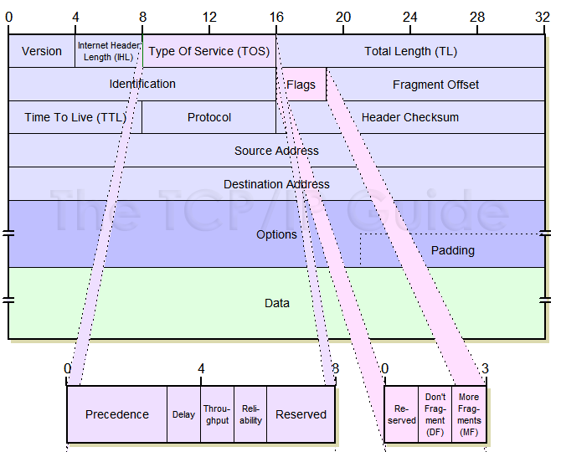
3. Explicit Congestion Notification (ECN)
An ECN aware router signals congestion using two reserved bits in the type-of-service field of the IP header
Routers operate at the ‘internet’ layer so they can only see and modify the IP header
CE bits in IP header

Slide 42
3. Explicit Congestion Notification (ECN)
The two CE bits can be set
00 – ECN not implemented
10 – ECN Capable Transport, ECT(0)
01 – ECN Capable Transport, ECT(1)
11 – Congestion Encountered, CE
Endpoints negotiate which bit is used by either side during the TCP handshake
Congestion signaled by setting the other reserved bit to ‘1’ so the field becomes ‘11’
Congestion can only be handled by TCP by reducing the Send (Congestion) Window

Slide 43
3. Explicit Congestion Notification (ECN)
On Congestion Encountered, CE bits ’11’ must be handled by TCP
The receivers IP layer notifies its TCP layer
Receiver’s TCP signals congestion to sender’s TCP by using bit 5 and 6 of the reserved bits of the TCP header
Bit 6 signals congestion
Bit 5 tells sender to reduce its Congestion Window

Slide 44
3. Selective Acknowledgment (SACK)
Problem
Traditional TCP acknowledges the value of the highest byte received before a lost segment.
Any lost packet requires retransmissions of all segments up to that point (wastes bandwidth).
Solution:
Selective Acknowledgement (SACK) allows a receiver to inform the sender about specific segments in the send window that have been successfully received, so only the lost packets are retransmitted.

Slide 45
3. Selective Acknowledgment (SACK)
Example:
Suppose a sender transmits data in the byte range 0–10,000, and packets corresponding to byte ranges 2,000–3,000 and 6,001–7,000 are lost.
Bytes | No SACK | SACK
0 – 1,999 | ACK | ACK
2,000 – 3,000 (lost) | Retransmit | Retransmit
3,001 – 6,000 | Retransmit | ACK
6,001 – 7,000 (lost) | Retransmit | Retransmit
7001 – 10,000 | Retransmit | ACK

Slide 46
3. Small packet – Nagle’s Algorithm
Problem:
Sender transmits TCP segments with large header compared to payload
wastes bandwidth (high overhead), creates congestion (many small packets)
e.g. Telnet apps that send one TCP segment per keystroke
Solution
Nagle’s Algorithm: Sender side strategy
Trade-off: Increased latency for lower overhead and congestion
1. Send first byte and accumulate new bytes while waiting for ACK
2. On ACK send accumulated bytes
3. Repeat

Slide 47
3. Silly Window Syndrome – Clark’s Algorithm
Problem:
A slow receiver sends ACK with a small window size
Sender can only send small TCP segment → Small Packet Problem (again)
Solution:
Clark’s Algorithm: Receiver side strategy
Trade-off: Increased latency for lower overhead and congestion
Wait for a minimum window size to be available in Rx buffer before sending ACK
Process data (freeing up buffer space) while waiting

Slide 48
References
INFO73180 – Data Communications and Networks, Michael Galle, Lecture slides and handouts
Computer Networks – A Top-Down Approach, Kurose and Ross
CSC358 – Introduction to Computer Networks, Peter Marbach lectures, https://www.cs.toronto.edu/~marbach/csc358_F19.html, accessed Dec. 2024.
http://www.tcpipguide.com/
Data Communications and Networking, Forouzan, McGraw-Hill

